Slide 1
Binomial coefficient

Slide 2

Binomial coefficient
The binomial coefficient for numbers $n≥k≥0$ is the number $\left(\begin{matrix}n \\ k\end{matrix}\right)$
(read „$n$ choose $k$”) defined by the formula:

Slide 3
Binomial coefficient
The binomial coefficient for numbers $n≥k≥0$ is the number $\left(\begin{matrix}n \\ k\end{matrix}\right)$
(read „$n$ choose $k$”) defined by the formula:
$$\left(\begin{matrix}n \\ k\end{matrix}\right)=\frac{n!}{k!\left(n−k\right)!}$$

Slide 4

Binomial coefficient
The binomial coefficient for numbers $n≥k≥0$ is the number $\left(\begin{matrix}n \\ k\end{matrix}\right)$
(read „$n$ choose $k$”) defined by the formula:
$$\left(\begin{matrix}n \\ k\end{matrix}\right)=\frac{n!}{k!\left(n−k\right)!}$$
Example: Calculate $\left(\begin{matrix}7 \\ 3\end{matrix}\right)$

Slide 5
Binomial coefficient
The binomial coefficient for numbers $n≥k≥0$ is the number $\left(\begin{matrix}n \\ k\end{matrix}\right)$
(read „$n$ choose $k$”) defined by the formula:
$$\left(\begin{matrix}n \\ k\end{matrix}\right)=\frac{n!}{k!\left(n−k\right)!}$$
Example: Calculate $\left(\begin{matrix}7 \\ 3\end{matrix}\right)$
$$\left(\begin{matrix}7 \\ 3\end{matrix}\right)=\frac{7!}{3!\left(7−3\right)!}$$

Slide 6
Binomial coefficient
The binomial coefficient for numbers $n≥k≥0$ is the number $\left(\begin{matrix}n \\ k\end{matrix}\right)$
(read „$n$ choose $k$”) defined by the formula:
$$\left(\begin{matrix}n \\ k\end{matrix}\right)=\frac{n!}{k!\left(n−k\right)!}$$
Example: Calculate $\left(\begin{matrix}7 \\ 3\end{matrix}\right)$
$$\left(\begin{matrix}7 \\ 3\end{matrix}\right)=\frac{7!}{3!\left(7−3\right)!}=\frac{7!}{3!4!}$$

Slide 7
Binomial coefficient
The binomial coefficient for numbers $n≥k≥0$ is the number $\left(\begin{matrix}n \\ k\end{matrix}\right)$
(read „$n$ choose $k$”) defined by the formula:
$$\left(\begin{matrix}n \\ k\end{matrix}\right)=\frac{n!}{k!\left(n−k\right)!}$$
Example: Calculate $\left(\begin{matrix}7 \\ 3\end{matrix}\right)$
$$\left(\begin{matrix}7 \\ 3\end{matrix}\right)=\frac{7!}{3!\left(7−3\right)!}=\frac{7!}{3!4!}=\frac{5⋅6⋅7}{3!}$$

Slide 8
Binomial coefficient
The binomial coefficient for numbers $n≥k≥0$ is the number $\left(\begin{matrix}n \\ k\end{matrix}\right)$
(read „$n$ choose $k$”) defined by the formula:
$$\left(\begin{matrix}n \\ k\end{matrix}\right)=\frac{n!}{k!\left(n−k\right)!}$$
Example: Calculate $\left(\begin{matrix}7 \\ 3\end{matrix}\right)$
$$\left(\begin{matrix}7 \\ 3\end{matrix}\right)=\frac{7!}{3!\left(7−3\right)!}=\frac{7!}{3!4!}=\frac{5⋅6⋅7}{3!}=\frac{5⋅6⋅7}{6}$$

Slide 9
Binomial coefficient
The binomial coefficient for numbers $n≥k≥0$ is the number $\left(\begin{matrix}n \\ k\end{matrix}\right)$
(read „$n$ choose $k$”) defined by the formula:
$$\left(\begin{matrix}n \\ k\end{matrix}\right)=\frac{n!}{k!\left(n−k\right)!}$$
Example: Calculate $\left(\begin{matrix}7 \\ 3\end{matrix}\right)$
$$\left(\begin{matrix}7 \\ 3\end{matrix}\right)=\frac{7!}{3!\left(7−3\right)!}=\frac{7!}{3!4!}=\frac{5⋅6⋅7}{3!}=\frac{5⋅6⋅7}{6}=5⋅7$$

Slide 10
Binomial coefficient
The binomial coefficient for numbers $n≥k≥0$ is the number $\left(\begin{matrix}n \\ k\end{matrix}\right)$
(read „$n$ choose $k$”) defined by the formula:
$$\left(\begin{matrix}n \\ k\end{matrix}\right)=\frac{n!}{k!\left(n−k\right)!}$$
Example: Calculate $\left(\begin{matrix}7 \\ 3\end{matrix}\right)$
$$\left(\begin{matrix}7 \\ 3\end{matrix}\right)=\frac{7!}{3!\left(7−3\right)!}=\frac{7!}{3!4!}=\frac{5⋅6⋅7}{3!}=\frac{5⋅6⋅7}{6}=5⋅7=35$$

Slide 11

Binomial coefficient
The binomial coefficient for numbers $n≥k≥0$ is the number $\left(\begin{matrix}n \\ k\end{matrix}\right)$
(read „$n$ choose $k$”) defined by the formula:
$$\left(\begin{matrix}n \\ k\end{matrix}\right)=\frac{n!}{k!\left(n−k\right)!}$$
Example: Calculate $\left(\begin{matrix}7 \\ 3\end{matrix}\right)$
$$\left(\begin{matrix}7 \\ 3\end{matrix}\right)=\frac{7!}{3!\left(7−3\right)!}=\frac{7!}{3!4!}=\frac{5⋅6⋅7}{3!}=\frac{5⋅6⋅7}{6}=5⋅7=35$$
For $n,k∈ℕ$ the number $\left(\begin{matrix}n \\ k\end{matrix}\right)∈ℕ_{+}$.

Slide 12
Binomial coefficient
The binomial coefficient for numbers $n≥k≥0$ is the number $\left(\begin{matrix}n \\ k\end{matrix}\right)$
(read „$n$ choose $k$”) defined by the formula:
$$\left(\begin{matrix}n \\ k\end{matrix}\right)=\frac{n!}{k!\left(n−k\right)!}$$
Basic properties:

Slide 13


Binomial coefficient
The binomial coefficient for numbers $n≥k≥0$ is the number $\left(\begin{matrix}n \\ k\end{matrix}\right)$
(read „$n$ choose $k$”) defined by the formula:
$$\left(\begin{matrix}n \\ k\end{matrix}\right)=\frac{n!}{k!\left(n−k\right)!}$$
Basic properties:
$$\left(\begin{matrix}n \\ k\end{matrix}\right)=\left(\begin{matrix}n \\ n−k\end{matrix}\right)$$

Slide 14

Binomial coefficient
The binomial coefficient for numbers $n≥k≥0$ is the number $\left(\begin{matrix}n \\ k\end{matrix}\right)$
(read „$n$ choose $k$”) defined by the formula:
$$\left(\begin{matrix}n \\ k\end{matrix}\right)=\frac{n!}{k!\left(n−k\right)!}$$
Basic properties:
$$\left(\begin{matrix}n \\ k\end{matrix}\right)=\left(\begin{matrix}n \\ n−k\end{matrix}\right)$$
$$\left(\begin{matrix}n \\ 0\end{matrix}\right)=\left(\begin{matrix}n \\ n\end{matrix}\right)=1$$

Slide 15

Binomial coefficient
The binomial coefficient for numbers $n≥k≥0$ is the number $\left(\begin{matrix}n \\ k\end{matrix}\right)$
(read „$n$ choose $k$”) defined by the formula:
$$\left(\begin{matrix}n \\ k\end{matrix}\right)=\frac{n!}{k!\left(n−k\right)!}$$
Basic properties:
$$\left(\begin{matrix}n \\ k\end{matrix}\right)=\left(\begin{matrix}n \\ n−k\end{matrix}\right)$$
$$\left(\begin{matrix}n \\ 0\end{matrix}\right)=\left(\begin{matrix}n \\ n\end{matrix}\right)=1$$
$$\left(\begin{matrix}n \\ 1\end{matrix}\right)=\left(\begin{matrix}n \\ n−1\end{matrix}\right)=n$$

Slide 16


Binomial coefficient
The binomial coefficient for numbers $n≥k≥0$ is the number $\left(\begin{matrix}n \\ k\end{matrix}\right)$
(read „$n$ choose $k$”) defined by the formula:
$$\left(\begin{matrix}n \\ k\end{matrix}\right)=\frac{n!}{k!\left(n−k\right)!}$$
Basic properties:
$$\left(\begin{matrix}n \\ k\end{matrix}\right)=\left(\begin{matrix}n \\ n−k\end{matrix}\right)$$
$$\left(\begin{matrix}n \\ k\end{matrix}\right)=\left(\begin{matrix}n−1 \\ k−1\end{matrix}\right)+\left(\begin{matrix}n−1 \\ k\end{matrix}\right)$$
$$\left(\begin{matrix}n \\ 0\end{matrix}\right)=\left(\begin{matrix}n \\ n\end{matrix}\right)=1$$
$$\left(\begin{matrix}n \\ 1\end{matrix}\right)=\left(\begin{matrix}n \\ n−1\end{matrix}\right)=n$$

Slide 17

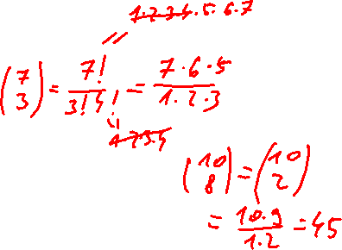
Binomial coefficient
The binomial coefficient for numbers $n≥k≥0$ is the number $\left(\begin{matrix}n \\ k\end{matrix}\right)$
(read „$n$ choose $k$”) defined by the formula:
$$\left(\begin{matrix}n \\ k\end{matrix}\right)=\frac{n!}{k!\left(n−k\right)!}$$
Basic properties:
$$\left(\begin{matrix}n \\ k\end{matrix}\right)=\left(\begin{matrix}n \\ n−k\end{matrix}\right)$$
$$\left(\begin{matrix}n \\ k\end{matrix}\right)=\left(\begin{matrix}n−1 \\ k−1\end{matrix}\right)+\left(\begin{matrix}n−1 \\ k\end{matrix}\right)$$
$$\left(\begin{matrix}n \\ 0\end{matrix}\right)=\left(\begin{matrix}n \\ n\end{matrix}\right)=1$$
$$\left(\begin{matrix}n \\ k\end{matrix}\right)=\frac{n⋅\left(n−1\right)⋅\left(n−2\right)⋅…⋅\left(n−k+1\right)}{1⋅2⋅3⋅…⋅k}$$
$$\left(\begin{matrix}n \\ 1\end{matrix}\right)=\left(\begin{matrix}n \\ n−1\end{matrix}\right)=n$$

Slide 18
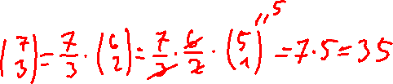

Binomial coefficient
The binomial coefficient for numbers $n≥k≥0$ is the number $\left(\begin{matrix}n \\ k\end{matrix}\right)$
(read „$n$ choose $k$”) defined by the formula:
$$\left(\begin{matrix}n \\ k\end{matrix}\right)=\frac{n!}{k!\left(n−k\right)!}$$
Basic properties:
$$\left(\begin{matrix}n \\ k\end{matrix}\right)=\left(\begin{matrix}n \\ n−k\end{matrix}\right)$$
$$\left(\begin{matrix}n \\ k\end{matrix}\right)=\left(\begin{matrix}n−1 \\ k−1\end{matrix}\right)+\left(\begin{matrix}n−1 \\ k\end{matrix}\right)$$
$$\left(\begin{matrix}n \\ 0\end{matrix}\right)=\left(\begin{matrix}n \\ n\end{matrix}\right)=1$$
$$\left(\begin{matrix}n \\ k\end{matrix}\right)=\frac{n⋅\left(n−1\right)⋅\left(n−2\right)⋅…⋅\left(n−k+1\right)}{1⋅2⋅3⋅…⋅k}$$
$$\left(\begin{matrix}n \\ 1\end{matrix}\right)=\left(\begin{matrix}n \\ n−1\end{matrix}\right)=n$$
$$\left(\begin{matrix}n \\ k\end{matrix}\right)=\frac{n}{k}\left(\begin{matrix}n−1 \\ k−1\end{matrix}\right)$$

Slide 19


Binomial coefficient
The binomial coefficient for numbers $n≥k≥0$ is the number $\left(\begin{matrix}n \\ k\end{matrix}\right)$
(read „$n$ choose $k$”) defined by the formula:
$$\left(\begin{matrix}n \\ k\end{matrix}\right)=\frac{n!}{k!\left(n−k\right)!}$$
Basic properties:
$$\sum_{k=0}^{n}{\left(\begin{matrix}n \\ k\end{matrix}\right)}=2^{n}$$
$$\left(\begin{matrix}n \\ k\end{matrix}\right)=\left(\begin{matrix}n \\ n−k\end{matrix}\right)$$
$$\left(\begin{matrix}n \\ k\end{matrix}\right)=\left(\begin{matrix}n−1 \\ k−1\end{matrix}\right)+\left(\begin{matrix}n−1 \\ k\end{matrix}\right)$$
$$\left(\begin{matrix}n \\ 0\end{matrix}\right)=\left(\begin{matrix}n \\ n\end{matrix}\right)=1$$
$$\left(\begin{matrix}n \\ k\end{matrix}\right)=\frac{n⋅\left(n−1\right)⋅\left(n−2\right)⋅…⋅\left(n−k+1\right)}{1⋅2⋅3⋅…⋅k}$$
$$\left(\begin{matrix}n \\ 1\end{matrix}\right)=\left(\begin{matrix}n \\ n−1\end{matrix}\right)=n$$
$$\left(\begin{matrix}n \\ k\end{matrix}\right)=\frac{n}{k}\left(\begin{matrix}n−1 \\ k−1\end{matrix}\right)$$

Slide 20

Binomial coefficient
The binomial theorem (binomial expansion):
$${\left(x+y\right)}^{1}=x+y$$

Slide 21

Binomial coefficient
The binomial theorem (binomial expansion):
$${\left(x+y\right)}^{1}=x+y$$
$${\left(x+y\right)}^{2}=x^{2}+2xy+y^{2}$$

Slide 22

Binomial coefficient
The binomial theorem (binomial expansion):
$${\left(x+y\right)}^{1}=x+y$$
$${\left(x+y\right)}^{2}=x^{2}+2xy+y^{2}$$
$${\left(x+y\right)}^{3}=x^{3}+3x^{2}y+3xy^{2}+y^{3}$$

Slide 23
Binomial coefficient
The binomial theorem (binomial expansion):
$${\left(x+y\right)}^{1}=x+y$$
$${\left(x+y\right)}^{2}=x^{2}+2xy+y^{2}$$
$${\left(x+y\right)}^{3}=x^{3}+3x^{2}y+3xy^{2}+y^{3}$$
$${\left(x+y\right)}^{4}=x^{4}+4x^{3}y+6x^{2}y^{2}+4xy^{3}+y^{4}$$

Slide 24
Binomial coefficient
The binomial theorem (binomial expansion):
$${\left(x+y\right)}^{1}=x+y$$
$${\left(x+y\right)}^{2}=x^{2}+2xy+y^{2}$$
$${\left(x+y\right)}^{3}=x^{3}+3x^{2}y+3xy^{2}+y^{3}$$
$${\left(x+y\right)}^{4}=x^{4}+4x^{3}y+6x^{2}y^{2}+4xy^{3}+y^{4}$$
$${\left(x+y\right)}^{5}=x^{5}+5x^{4}y+10x^{3}y^{2}+10x^{2}y^{3}+5xy^{4}+y^{5}$$

Slide 25



Binomial coefficient
The binomial theorem (binomial expansion):
$${\left(x−y\right)}^{1}=x−y$$
$${\left(x−y\right)}^{2}=x^{2}−2xy+y^{2}$$
$${\left(x−y\right)}^{3}=x^{3}−3x^{2}y+3xy^{2}−y^{3}$$
$${\left(x−y\right)}^{4}=x^{4}−4x^{3}y+6x^{2}y^{2}−4xy^{3}+y^{4}$$
$${\left(x−y\right)}^{5}=x^{5}−5x^{4}y+10x^{3}y^{2}−10x^{2}y^{3}+5xy^{4}−y^{5}$$

Slide 26
Binomial coefficient
The binomial theorem (binomial expansion):
$${\left(x+y\right)}^{1}=x+y$$
$${\left(x+y\right)}^{2}=x^{2}+2xy+y^{2}$$
$${\left(x+y\right)}^{3}=x^{3}+3x^{2}y+3xy^{2}+y^{3}$$
$${\left(x+y\right)}^{4}=x^{4}+4x^{3}y+6x^{2}y^{2}+4xy^{3}+y^{4}$$
$${\left(x+y\right)}^{5}=x^{5}+5x^{4}y+10x^{3}y^{2}+10x^{2}y^{3}+5xy^{4}+y^{5}$$

Slide 27


Binomial coefficient
The binomial theorem (binomial expansion):
$${\left(x+y\right)}^{1}=x+y$$
$${\left(x+y\right)}^{2}=x^{2}+\left(\begin{matrix}2 \\ 1\end{matrix}\right)xy+y^{2}$$
$${\left(x+y\right)}^{3}=x^{3}+\left(\begin{matrix}3 \\ 1\end{matrix}\right)x^{2}y+\left(\begin{matrix}3 \\ 2\end{matrix}\right)xy^{2}+y^{3}$$
$${\left(x+y\right)}^{4}=x^{4}+\left(\begin{matrix}4 \\ 1\end{matrix}\right)x^{3}y+\left(\begin{matrix}4 \\ 2\end{matrix}\right)x^{2}y^{2}+\left(\begin{matrix}4 \\ 3\end{matrix}\right)xy^{3}+y^{4}$$
$${\left(x+y\right)}^{5}=x^{5}+\left(\begin{matrix}5 \\ 1\end{matrix}\right)x^{4}y+\left(\begin{matrix}5 \\ 2\end{matrix}\right)x^{3}y^{2}+\left(\begin{matrix}5 \\ 3\end{matrix}\right)x^{2}y^{3}+\left(\begin{matrix}5 \\ 4\end{matrix}\right)xy^{4}+y^{5}$$

Slide 28
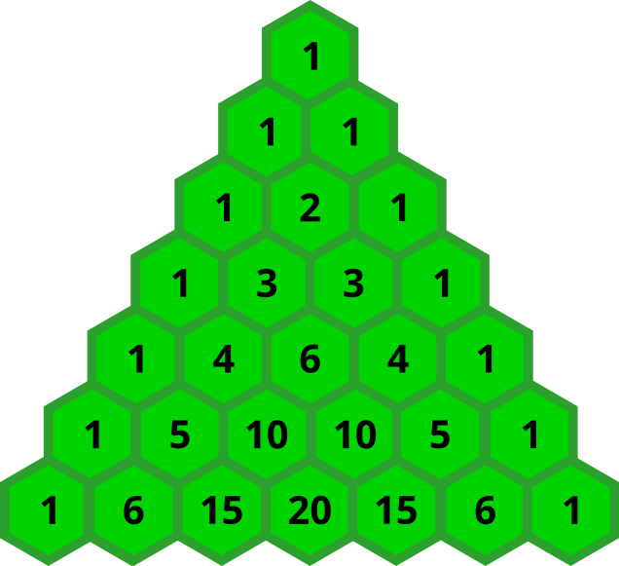
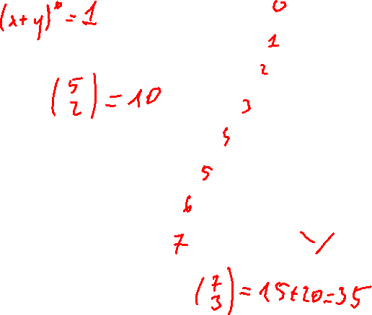
Binomial coefficient
The binomial theorem (binomial expansion):
$${\left(x+y\right)}^{1}=x+y$$
$${\left(x+y\right)}^{2}=x^{2}+2xy+y^{2}$$
$${\left(x+y\right)}^{3}=x^{3}+3x^{2}y+3xy^{2}+y^{3}$$
$${\left(x+y\right)}^{4}=x^{4}+4x^{3}y+6x^{2}y^{2}+4xy^{3}+y^{4}$$
$${\left(x+y\right)}^{5}=x^{5}+5x^{4}y+10x^{3}y^{2}+10x^{2}y^{3}+5xy^{4}+y^{5}$$

